Slide 1
Groundwater Dynamics AWD
CT4420 illustrative addendum to chapter 5 of Groundwater Science

Slide 2
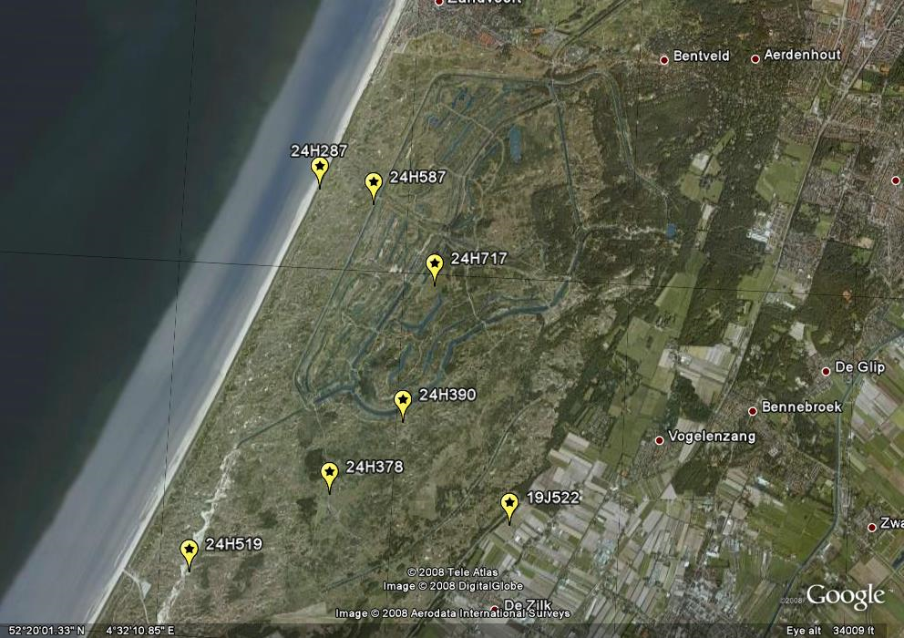
Amsterdam Water Supply Area with selected piezometer

Slide 3
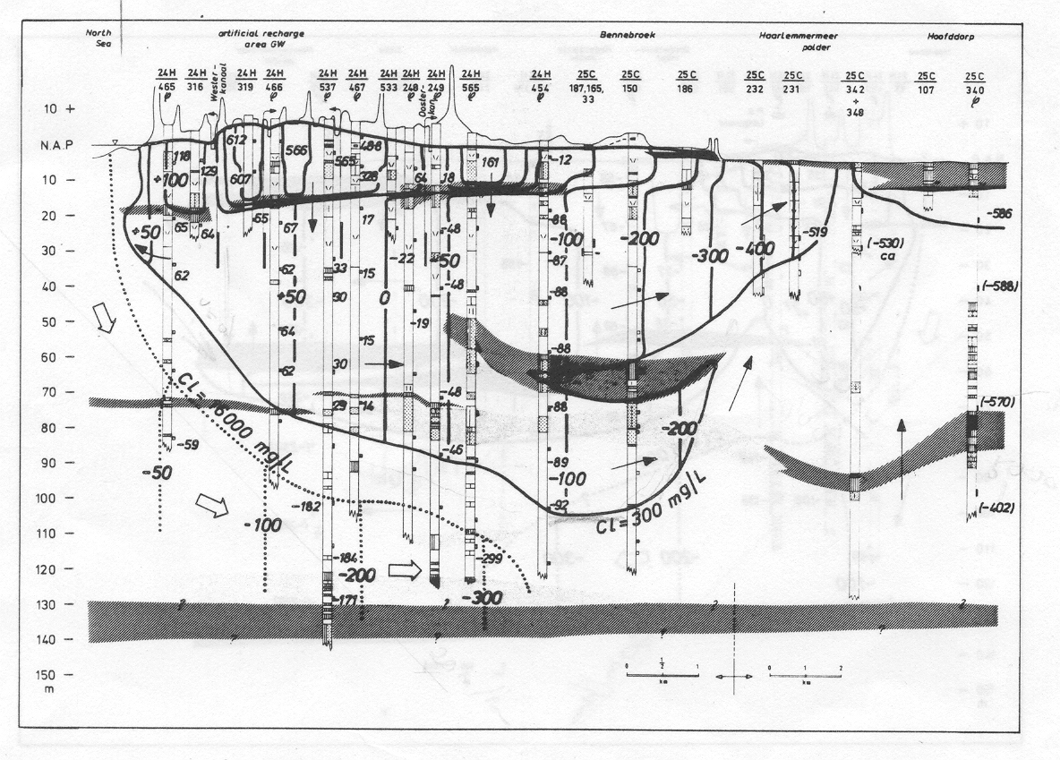
Cross section west-east

Slide 4
Time series analyses

Slide 5
Time series analysis

Slide 6
Groot Zwarteveld (shallow water table large system) summer

Slide 7
Groot Zwarteveld (shallow water table large system) summer

Slide 8
Groot Zwarteveld (shallow water table large system) winter

Slide 9
Flower bulb field De Zilk (shallow water table small system)

Slide 10
Haasveld central AWD (deep water table large system) water table and deep head

Slide 11
200 m south of Kromme Schuster AWD (confined head and barometer)

Slide 12
200 m south of Kromme Schuster AWD (confined head and barometer)
Barometer efficiency is ca. 75% in this shallow semi-confined aquifer

Slide 13
Tide North Sea IJmuiden 15 min behind Noordwijk

Slide 14
Tide in semi-confined aquifer versus distance from sea

Slide 15
Tide in semi-confined aquifer versus distance from sea

Slide 16
Phreatic and confined aquifer tide close to the beach

Slide 17
Phreatic and confined aquifer tide close to the beach

Slide 18
Effect of puming on head in semi-confined aquifer

Slide 19
Total extraction deep wells

Slide 20
Drawdown by pumping

Slide 21
Drawdown with distance

Slide 22
Head in a gallery in the AWD showing extraction

Slide 23
Head in a gallery in AWD showing extaction

